Slide 1
Crop Production Analysis in India
By- Kumari Neha

Slide 2
Introduction
Agriculture is a vital part of the global supply chain and is evolving with advancements in technology.
This project focuses on analyzing crop production data in India over the years.
The aim is to understand production trends, find key influencing factors, and predict future yields.

Slide 3
Objective
To analyze historical crop production trends across different regions and time periods.
To identify key factors, such as season, crop type, and geography, that influence crop production.
To build a predictive model that forecasts future crop yields using machine learning techniques.
To provide insights and recommendations for optimizing agricultural practices and resource allocation.

Slide 4
Steps
Load and clean the dataset to prepare it for analysis.
Analyze trends and correlations through visualizations and EDA.
Identify and engineer key features impacting crop production.
Train machine learning models to predict crop yields.
Visualize insights and highlight important factors influencing production.
Predict future yields and provide actionable recommendations.

Slide 5
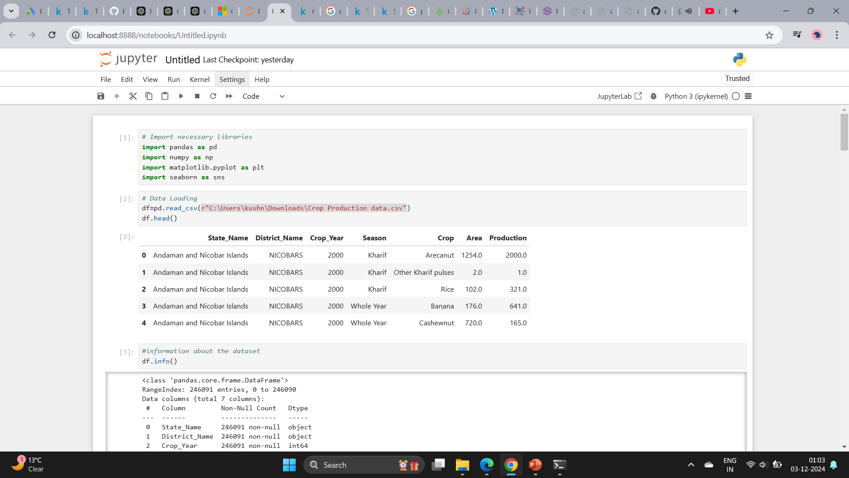

Slide 6
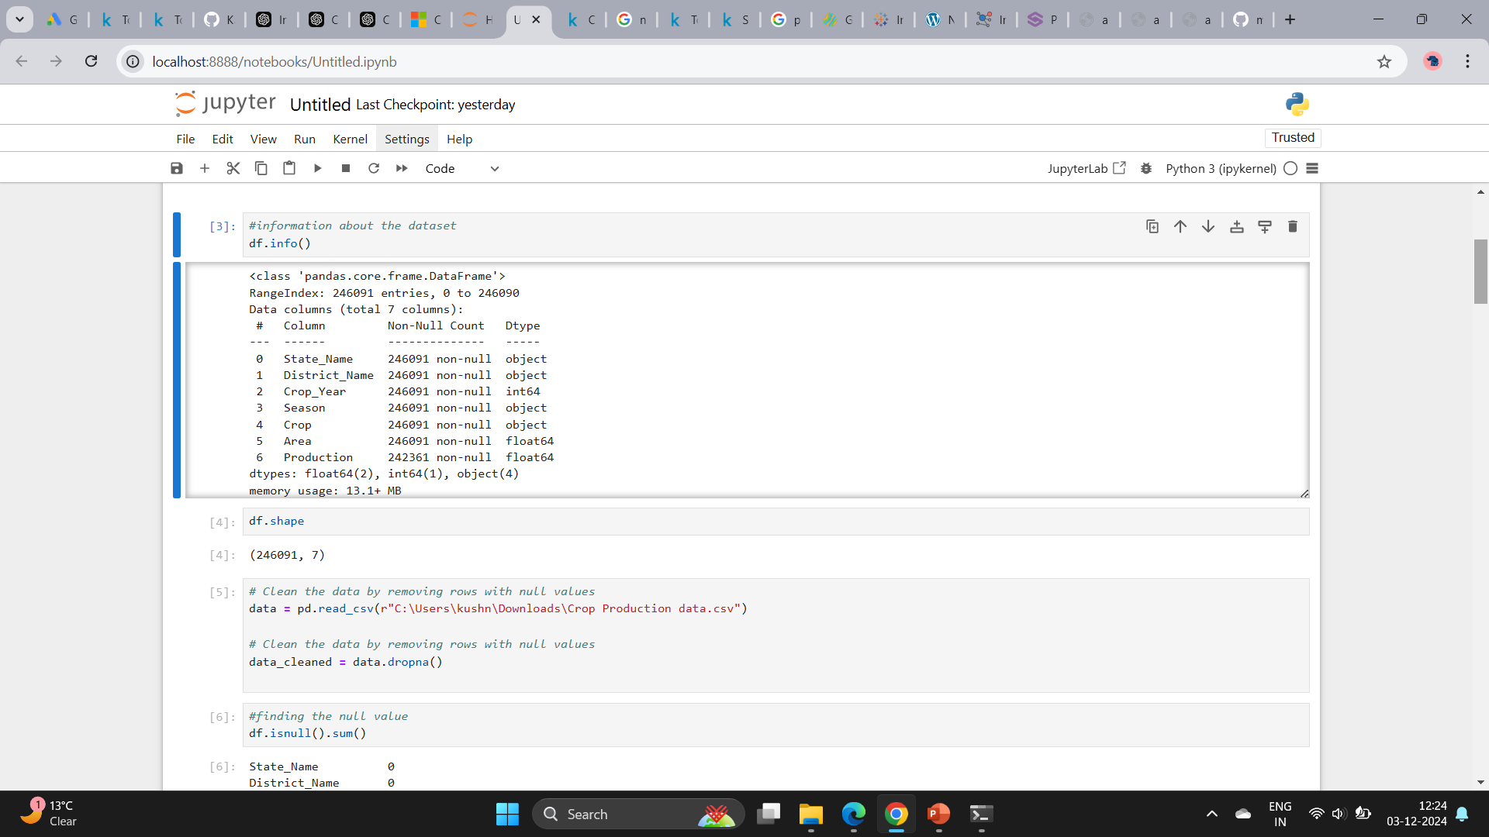

Slide 7
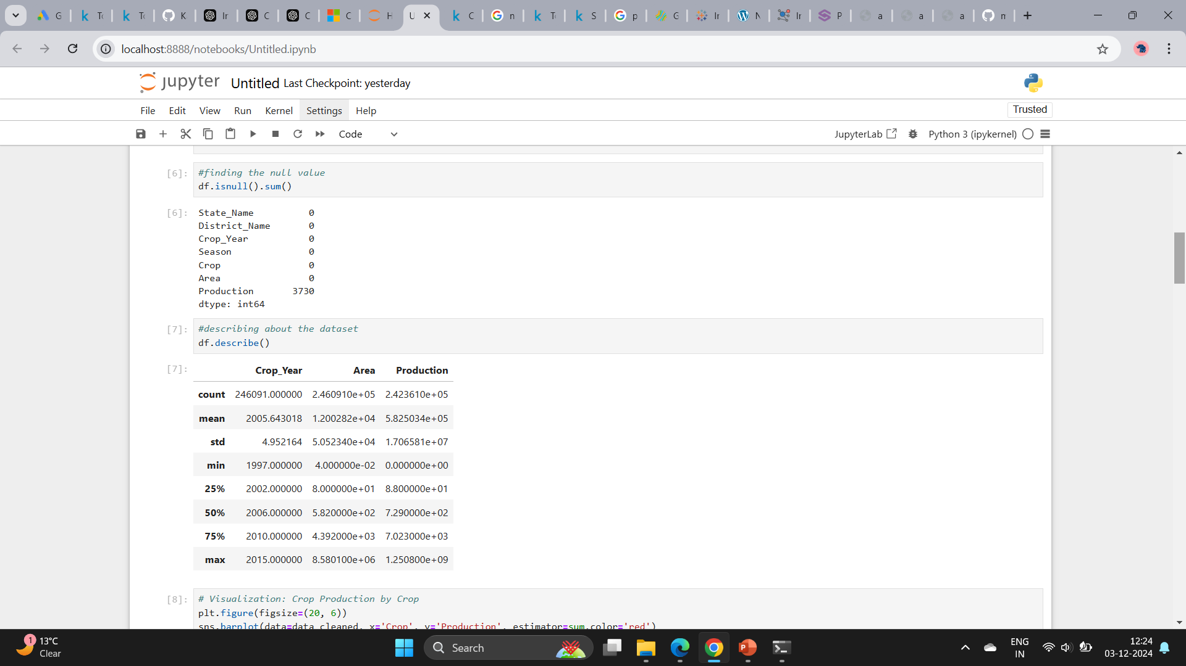

Slide 8
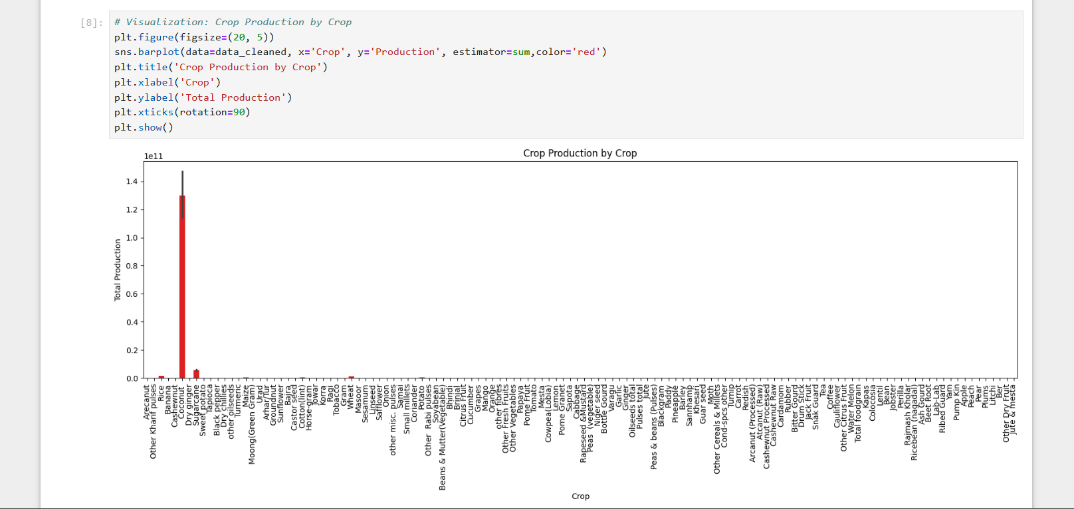

Slide 9
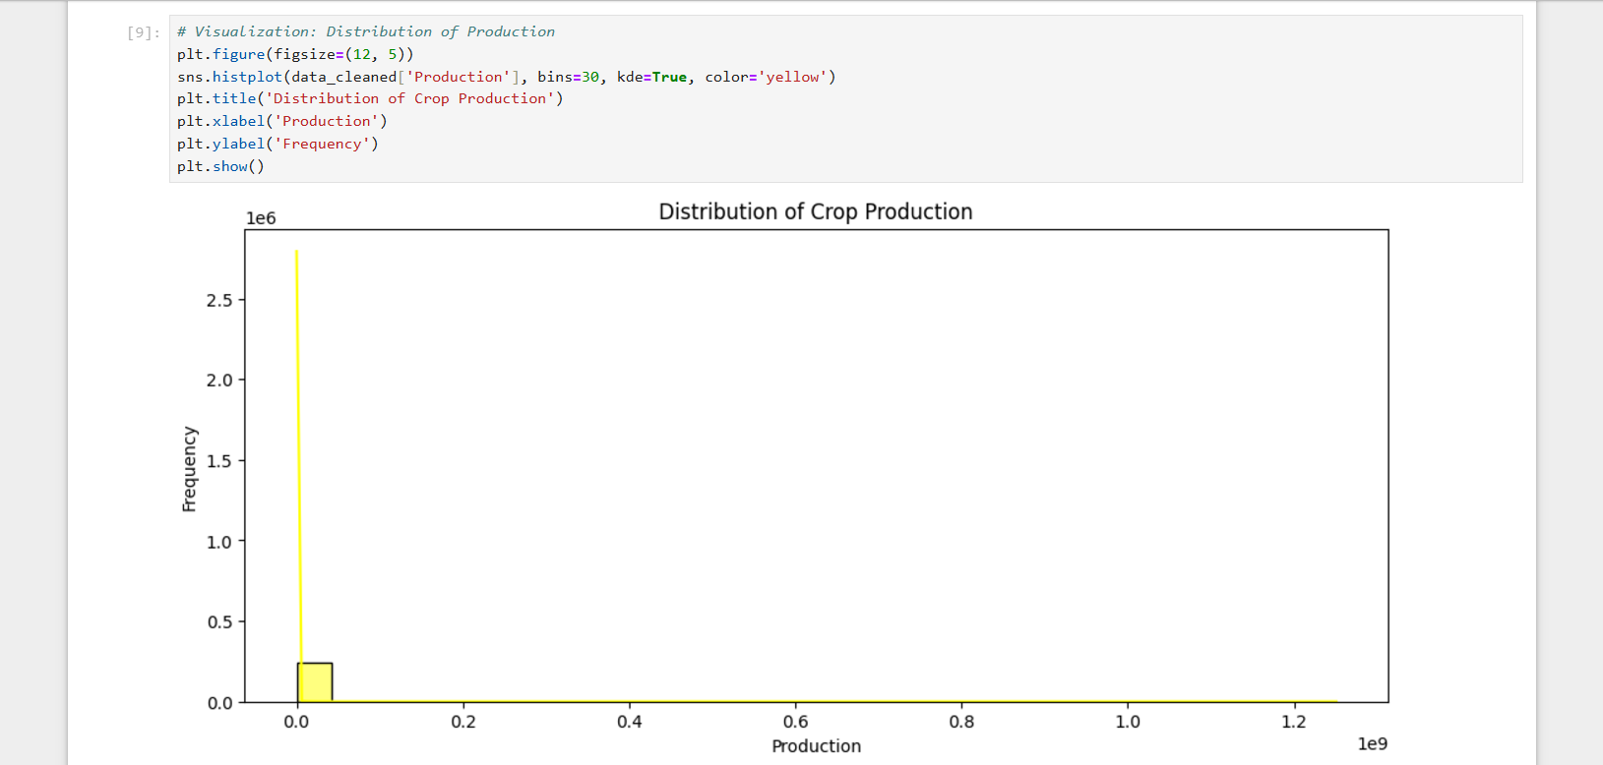

Slide 10
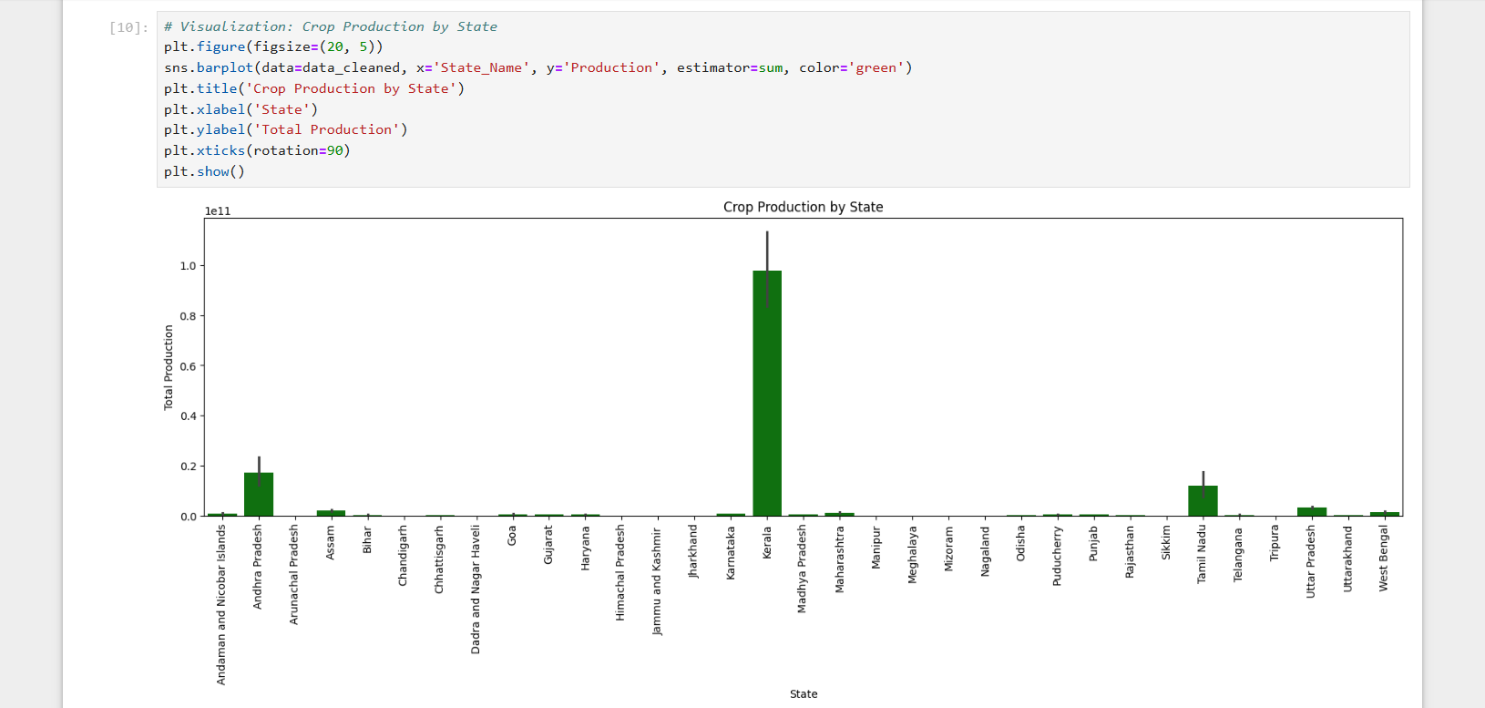

Slide 11
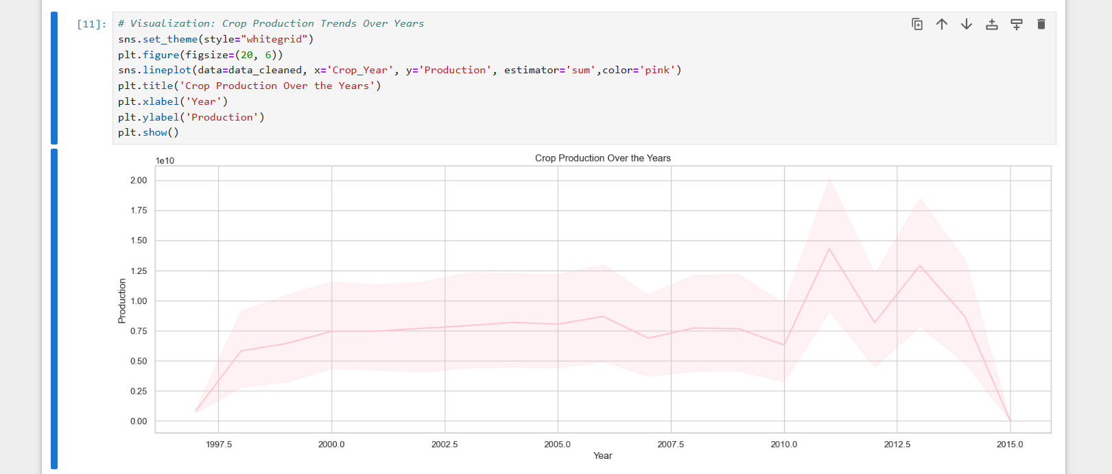

Slide 12
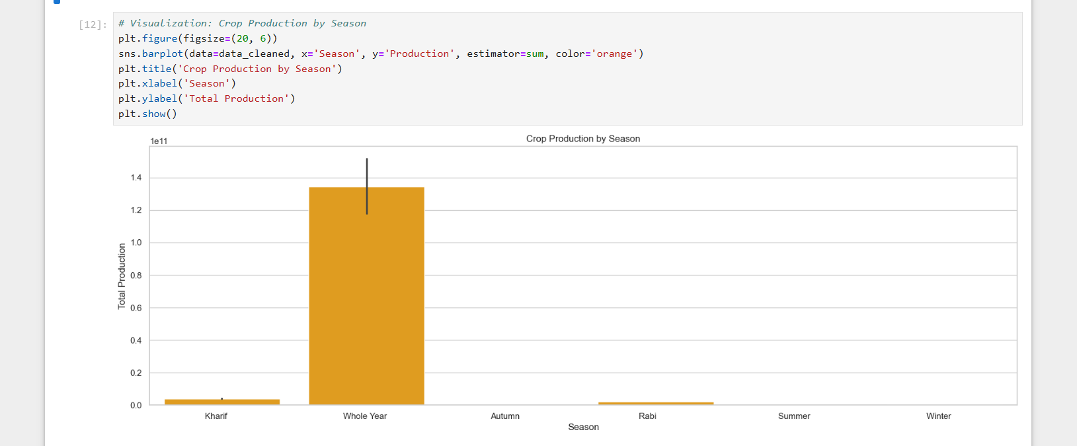

Slide 13
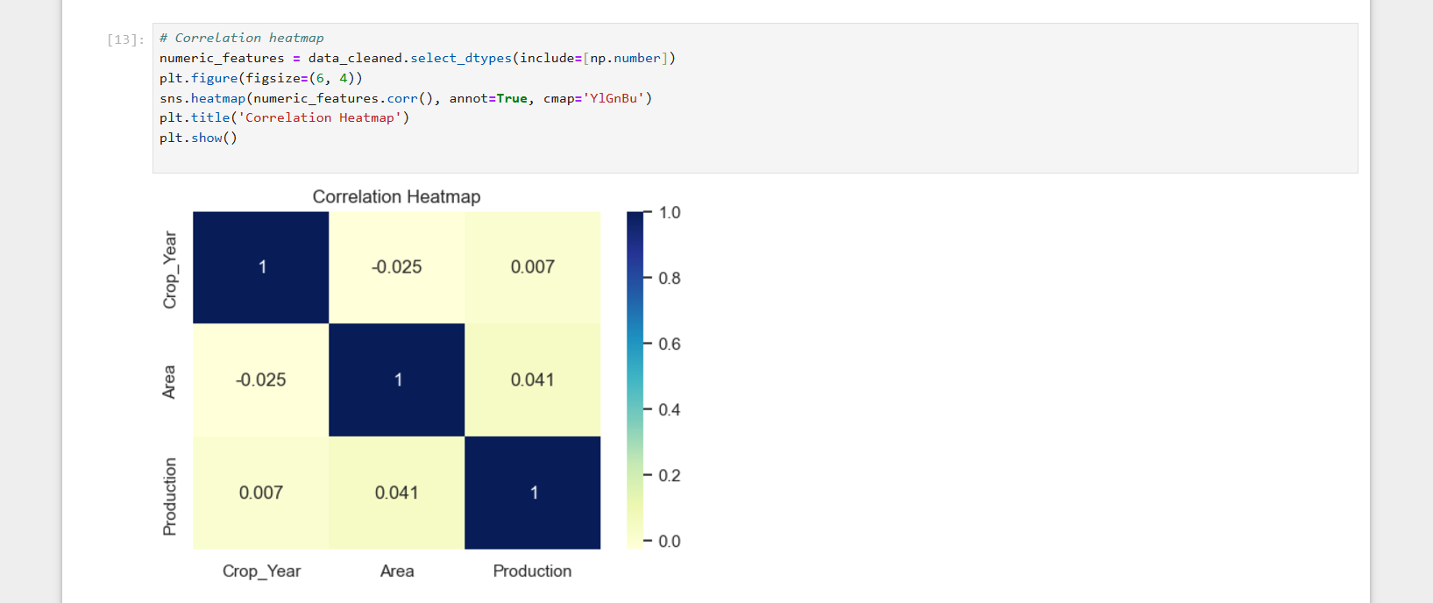

Slide 14
Future Impact
This project can help farmers optimize crop planning and resource use, enabling better productivity. Policymakers can design improved strategies for food security and regional support.
Businesses can streamline supply chains, reducing waste and meeting demand efficiently, fostering sustainable agriculture.

Slide 15
Conclusion
This project analyzes crop data to understand trends and predict yields. The insights help stakeholders make better decisions and support sustainable agriculture.
It shows how technology can improve farming practices and enhance productivity.

Slide 16
THANK YOU

